Slide 1

Visual and text analytics on NSF awards
YarA SEIF
MOHAMMAD AL-SHAMI
FAIRUS TANZIM
ASIF TURZO
RADUAN

Slide 2
Visual and text analytics on NSF awards With an annual budget of $8.5 billion (FY 2021), the National Science Foundation (NSF) are the funding source for approximately 25 percent of all federally supported basic research conducted by America's colleges and universities. In many fields such as mathematics, computer science and the social sciences, NSF is the major source of federal backing.

Slide 3
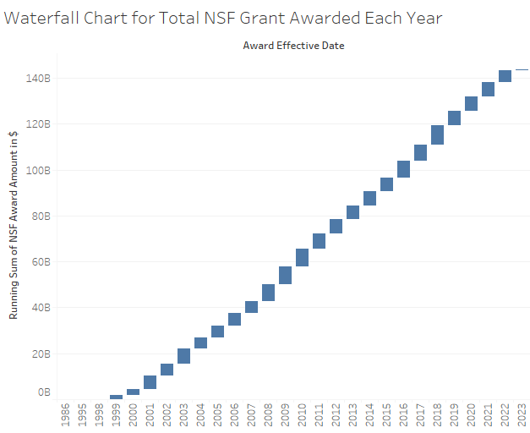
This Waterfall Chart is showing the running total amount of NSF grant awarded from year of 1986 to 2023. Total $140B has been awarded over 35 years and highest amount of NSF grant was awarded in 2008, 2009 and 2010 and again in 2017, 2018 and 2019, which was more than $7B.

Slide 4

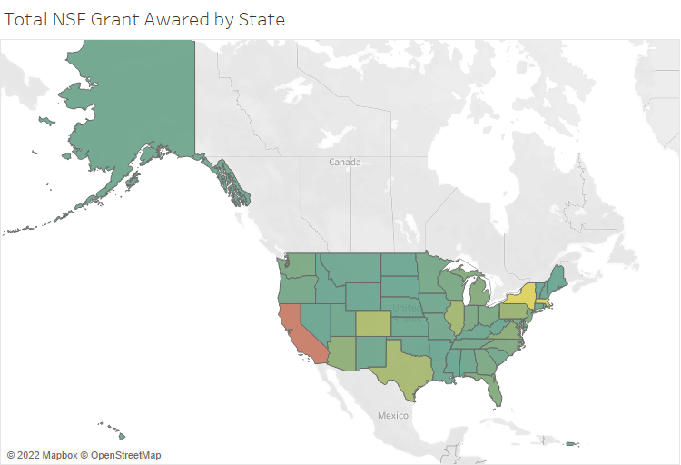
Over this 35 years, highest amount of total NSF grant has been awarded to the institutes in the State of California which is around $20B. At the same time, Institutes from Midwest States of USA has received around total $5B each. This analysis triggers to find out which Institutes are getting highest NSF grants each year.

Slide 5
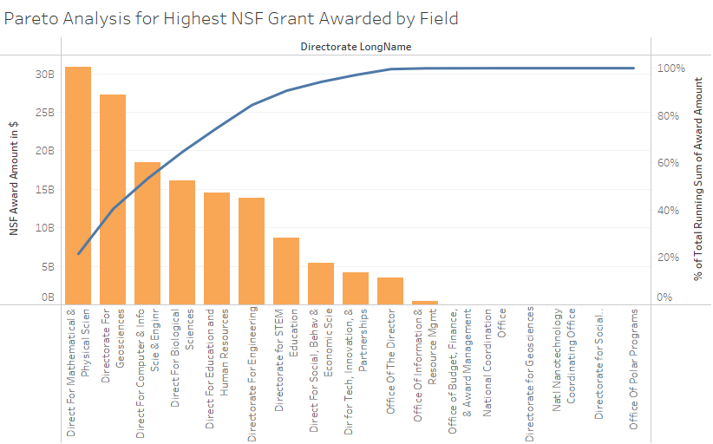
In this Analysis we tried to find out which Directorate Field of studies received significant amount of NSF grant. Pareto analysis shows that
Directorate for Mathematical & Physical Science
Directorate for Geoscience
Directorate for Computer & Information Science & Engineering
Directorate for Biological science
Directorate for Education and human resource
Directorate for Engineering
These field received 80% of the total NSF grant over this 35 years.

Slide 6
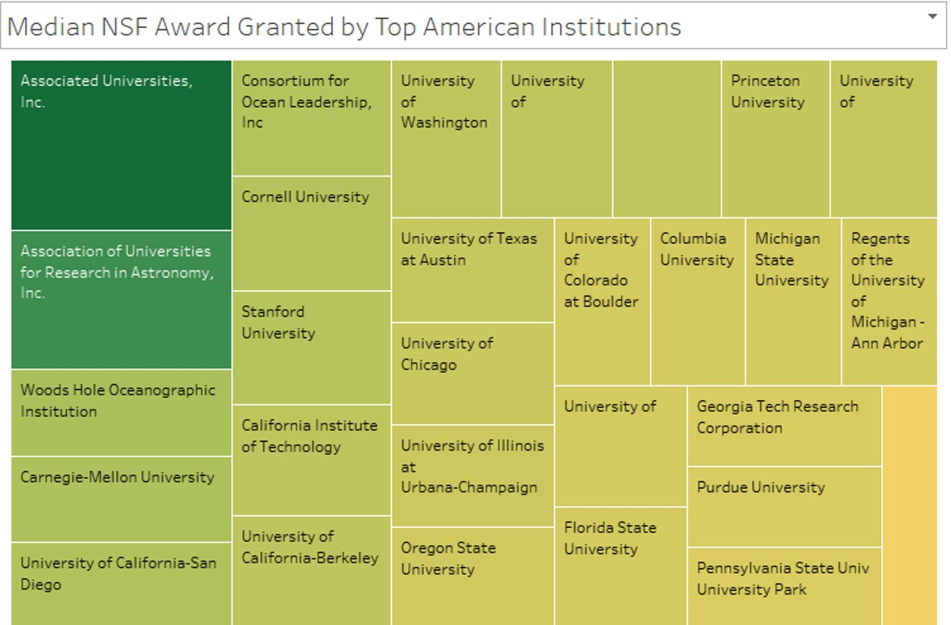
We tried to analysis the institutions which received highest median NSF grant each year over these 6 Directorate field of studies. We listed total 29 Institutions which has been received highest Median NSF grant each year. These institutions are working on focused 6 Directorate field of studies.

Slide 7
Next, we will display our data findings in Power BI dashboards, the visuals are embedded with real data interactions, the end-user can use these filters to alter the view to serve our purpose.

Slide 8
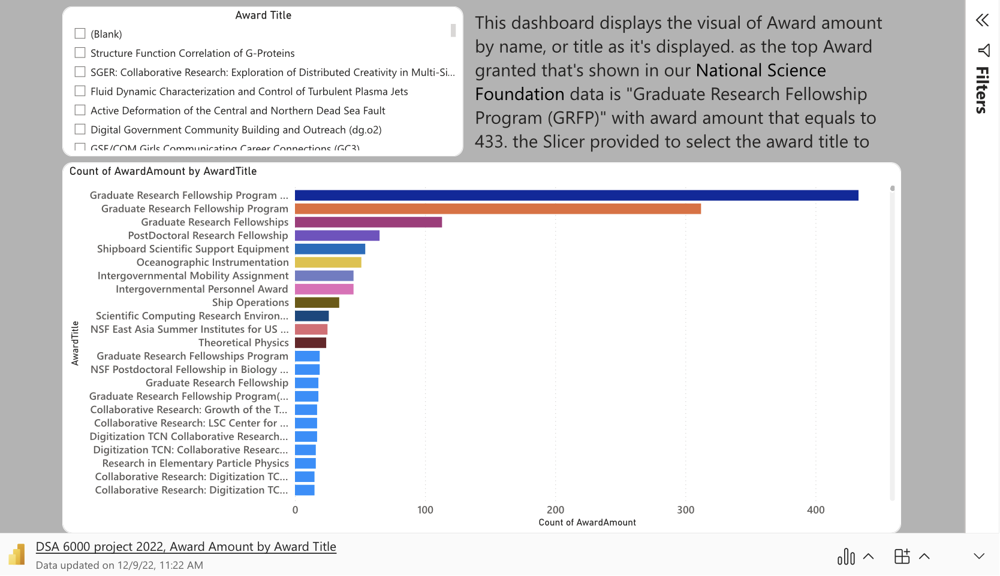

Slide 9
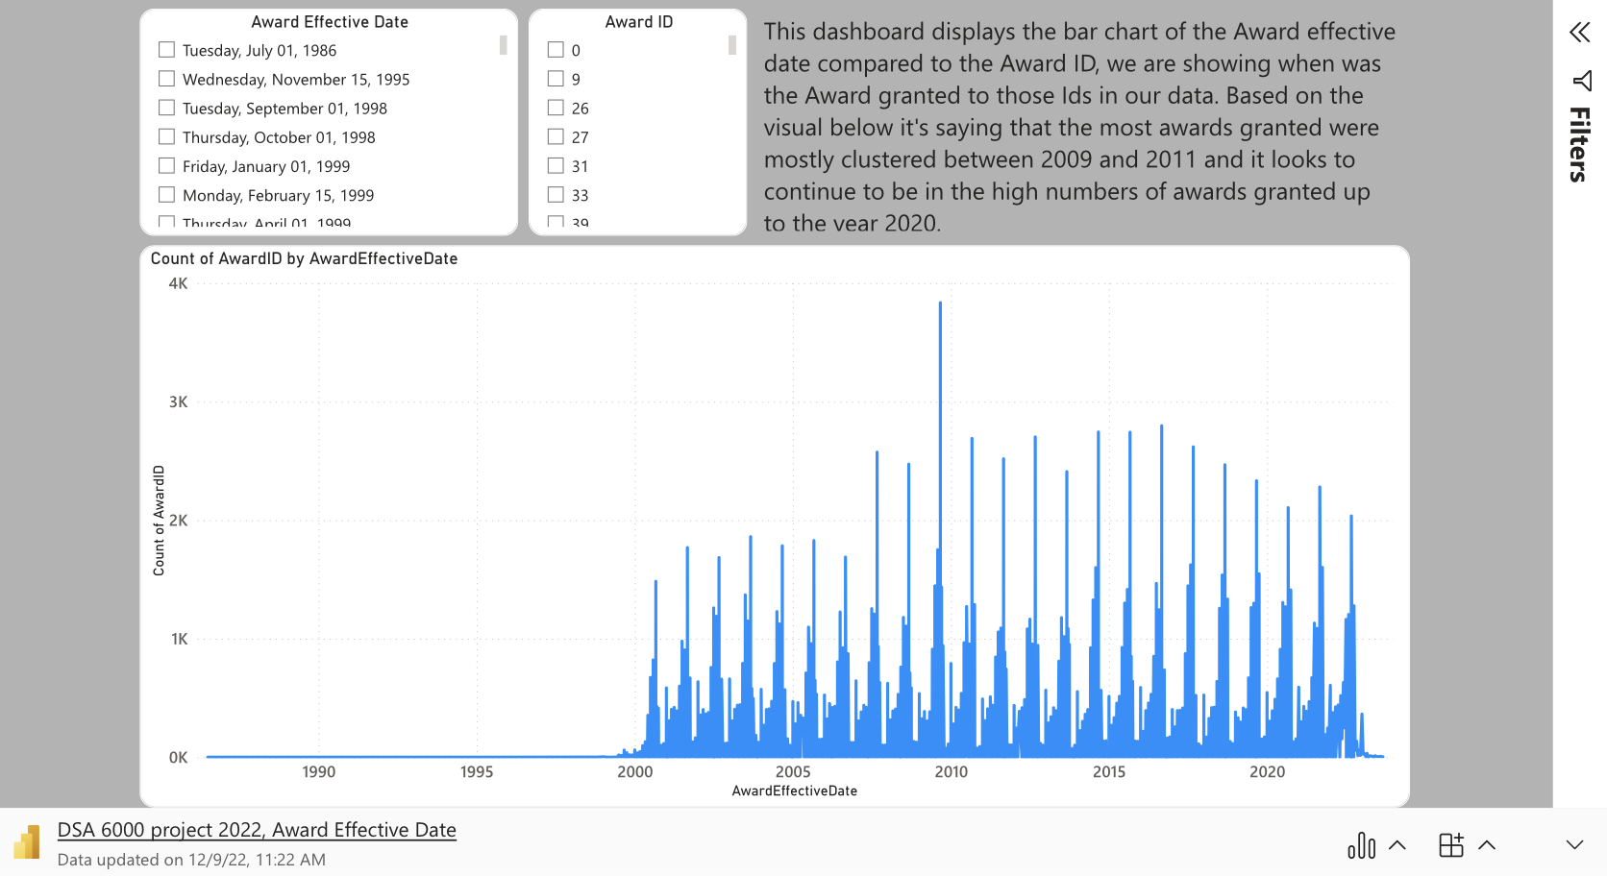

Slide 10
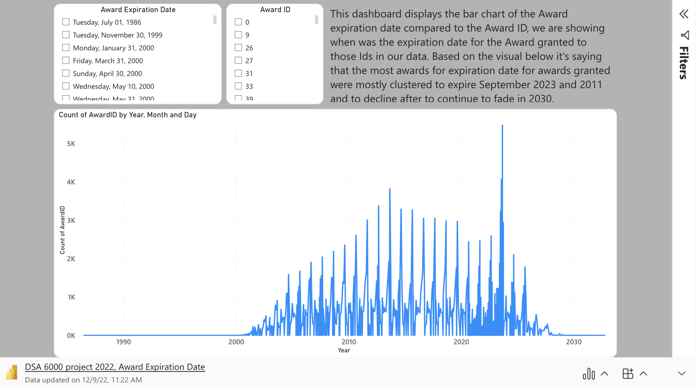

Slide 11
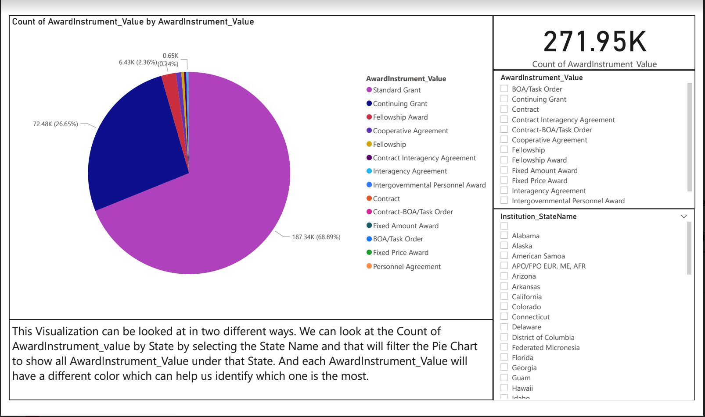

Slide 12
In our next slides, we will display the visuals for the Natural Language Processing (NLP)

Slide 13
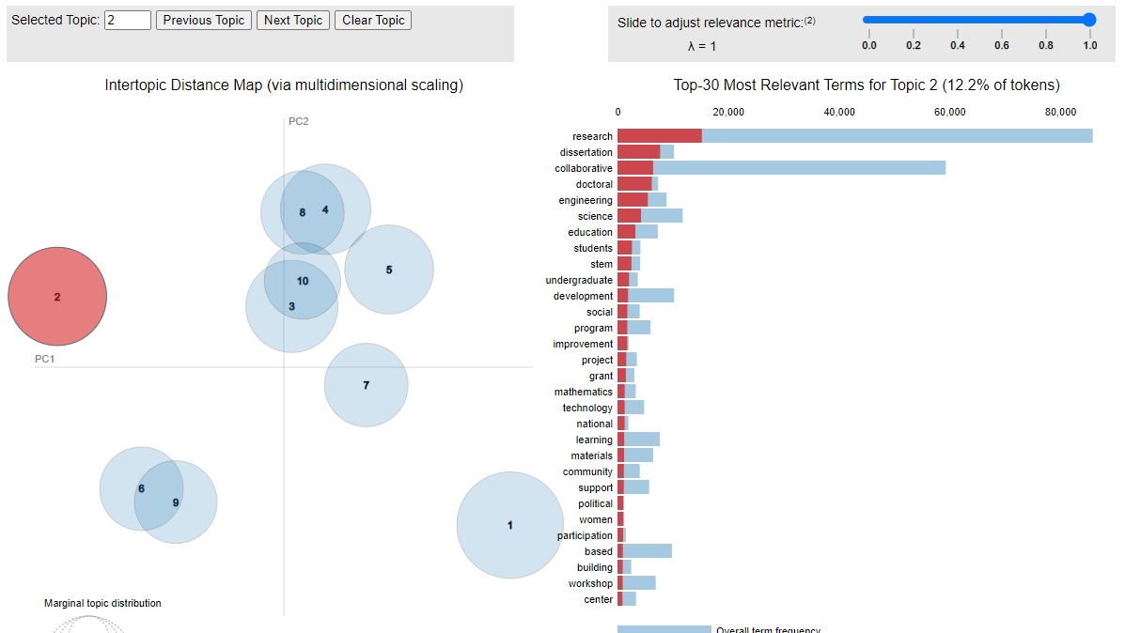

Slide 14
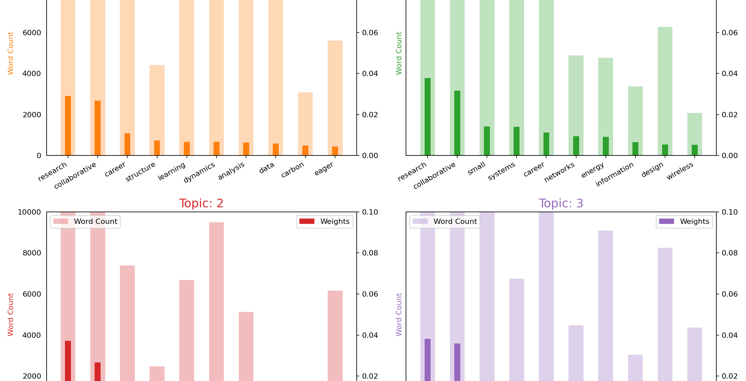

Slide 15
